Slide 1
Shell scripting

Slide 2
WHAT is a linux shell?
A Linux shell is a command-line interface (CLI) that allows users to interact with the operating system by typing commands. The shell interprets these commands and executes them. It acts as an intermediary between the user and the kernel, the core part of the operating system.

Slide 3
Types of shells
Bash (Bourne Again Shell)
Zsh (Z Shell)
Ksh (Korn Shell)
Tcsh (TENEX C Shell)

Slide 4
Shell script
A shell script is a text file containing a series of commands that can be executed by a shell.
They are used to automate repetitive tasks, manage system operations, and perform complex sequences of commands without user intervention.
It is important to note that Shell scripts are interpreted and not compiled.

Slide 5
to create a bash script
Choose directory where you want the script saved
Mention all the commands you want to executed in the script (
To run the script change the user permission of the script to allow execute , and then run the file (./filename.sh)

Slide 6
Scripting methods
Scripting format - #!/bin/bash
Sending output to screen – echo output
To call Variables in script -$VariableName
To get input from user – read VariableName
Use # to comment any line
For increment and decrement - num=$((num - 1)) , let num++ , let num--

Slide 7

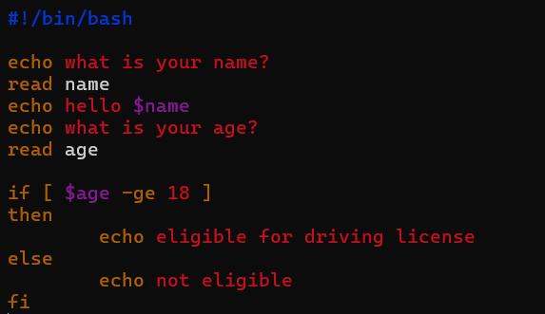
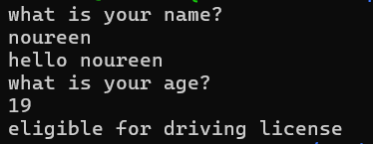
Few basic scripts

Slide 8
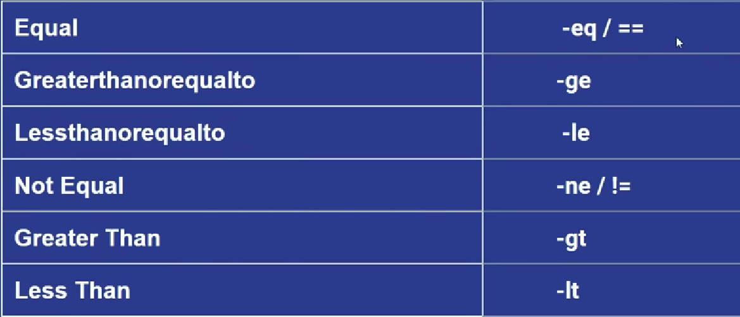

Slide 9
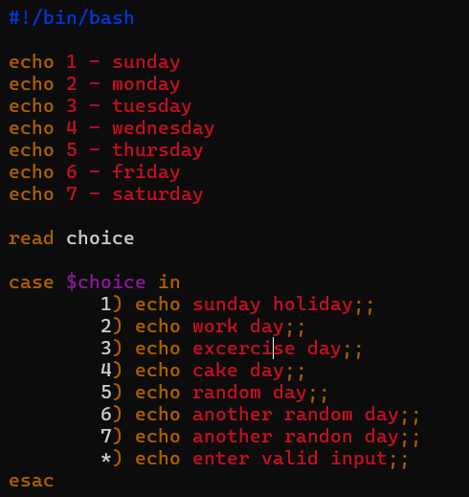
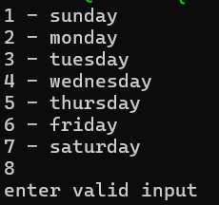

Slide 10
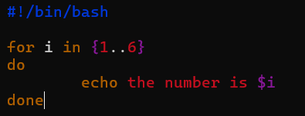
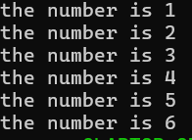
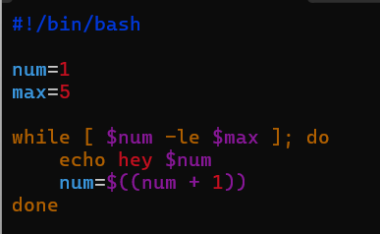


Slide 11
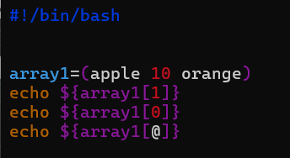

Array methods in shell scripting
to make an array variable=(numbers or letters or strings)
To access the elements of an array - ${arrayname[index]}
To access the entire array - ${arrayname[@]}

Slide 12
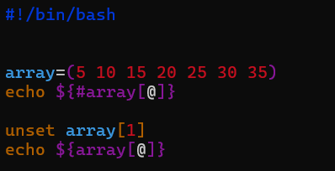

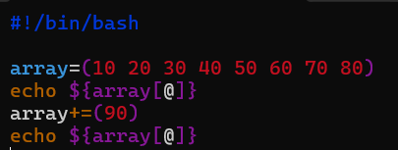

To get length of an array - ${#arrayname[@]}
To replace elements in the array- arrayname[index]=replaced_element
To remove elements in the array – unset arrayname[index]
To add an element – arrayname+=(element)

Slide 13
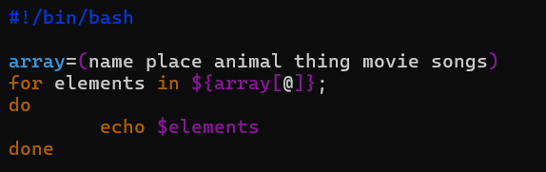
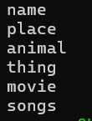
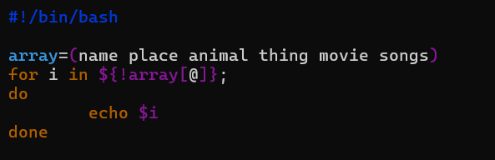

Looping elements in an array –
Looping index of elements in array -

Slide 14
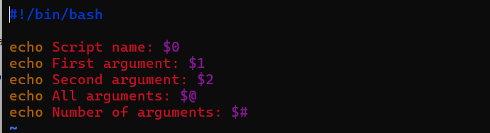
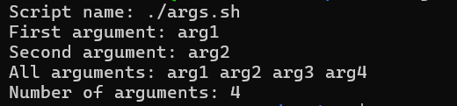
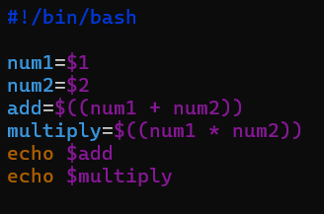

Command line argument

Slide 15
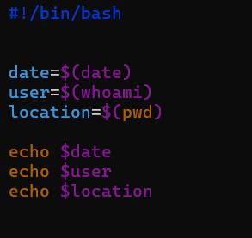

Command substitution
Assigning Command Output to a Variable

Slide 16
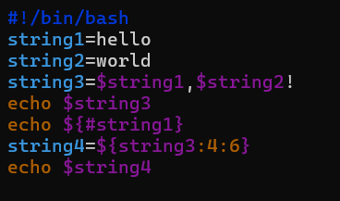

String operations
String concatenation
To get length of string
To get a substring

Slide 17
Thank you

